Slide 1
Computer Organization and Architecture
Dr. Hammad Afzal
20th Oct, 2010

Slide 2
Lecture 7
Instruction Sets:
Characteristics and Functions
Chapter 9 of William Stallings's Book: Computer Organization and Architecture

Slide 3
What is an Instruction Set? (1)
Operation of the processor is determined by the instruction it executes.
Functional requirements for processor
The complete collection of instructions that are understood by a CPU
Notes:
2

Slide 4
What is an Instruction Set? (2)
Boundary where computer programmer and computer designer can view the same machine.
Machine Code
Binary
Usually represented by assembly codes
Notes:
2

Slide 5
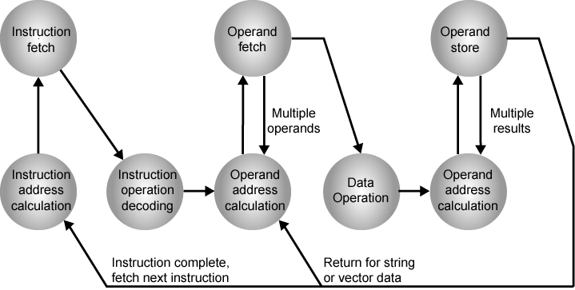
Instruction Cycle State Diagram

Slide 6
Elements of an Instruction (1)
Operation code (Op code)
Specifies operation to be performed. E.g. Add, I/O
Specified by binary code known as opcode
Source and Destination Operand reference
Specify the inputs and outputs for the operation
Next instruction reference
Notes:
3

Slide 7
Elements of an Instruction (2)
Operation code (Op code)
Following are general categories.
Arithmetic and logic operations
Movement of data between two registers
Movement of data register and memory
Movement of data between two memory locations
I/O
Control
Notes:
3

Slide 8
Elements of an Instruction (3)
Source and Destination Operand reference
Can be in one of three areas:
Main or virtual memory: Main or virtual memory address must be supplied.
Processor Register: Processors contain one or more registers that may be referenced by machine instruction.
I/O device: Instruction must specify the I/O module and device for the operation..
If memory-mapped I/O is used, this is just another main or virtual memory address (details later).
Notes:
3

Slide 9
Elements of an Instruction (4)
Next Instruction Reference
Where to fetch the next instruction once the current instruction is completed.
It can be in memory or in virtual memory (secondary memory).
In most cases, the instruction that immediately follows existing one.
Notes:
3

Slide 10
Instruction Representation
In machine code each instruction has a unique bit pattern
For human consumption (well, programmers anyway) a symbolic representation is used: operations are specified by abbreviations called mnemonics
E.g ADD, SUB, MPY, DIV, LOAD, STOR
Operands can also be represented by symbols
E.g ADD <Y>,<R>
Y is a memory location
R is register
Notes:
5

Slide 11
Instruction Representation
Machine language program can be written in symbolic form.
Each symbolic code has a fixed binary representation.
Programmer specifies the location of each symbolic operand.
E.g Initializing as X = 513
Notes:
5

Slide 12
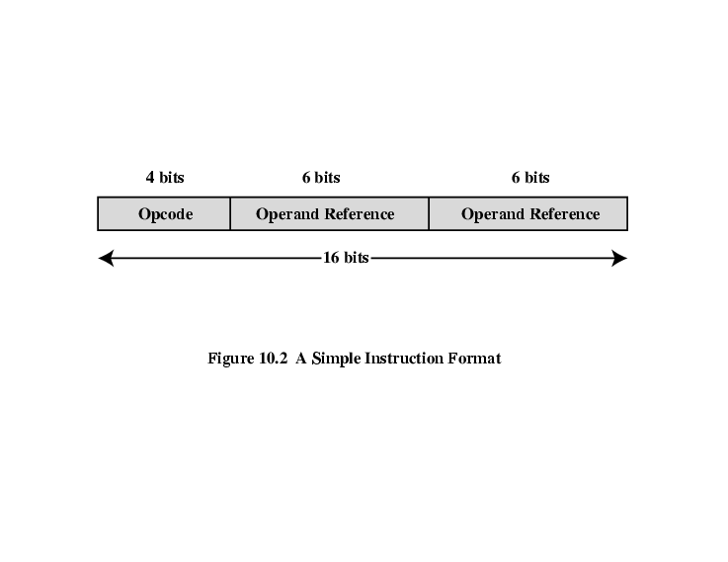
Simple Instruction Format
Instructions are fetched into IR register.
Processor must be able to extract the data from the various instructions fields to perform the required operation.

Slide 13
Instruction Types
Imagine a high level language’s statement:
X = X + Y
Add the value at memory location Y (assume 514) to that in memory location X (513) and store the result in memory location X.
3 instructions:
Load a register with contents of memory location 513.
Add the contents of memory location 514 to register.
Store the contents of register in memory location 513.
Notes:
6

Slide 14
Instruction Types
Data processing:
Arithmetic: computational capabilities for processing numeric data
Logic: operates on bits of word as bits rather than as numbers
Data storage (main memory)
Memory instructions
Data movement (I/O)
I/O instructions: transfer programs and data into memory and the results of computations back out to the user
Program flow control
Test: test the value of data word or status
Branch instructions: branch to different instructions
Notes:
6

Slide 15
Number of Addresses (a)
3 addresses
Operand 1, Operand 2, Result
a = b + c;
May be a forth - next instruction (usually implicit)
Not common
Needs very long words to hold everything
Notes:
7

Slide 16
Number of Addresses (b)
2 addresses
One address doubles as operand and result
a = a + b
Reduces length of instruction
Requires some extra work
Temporary storage to hold some results
Notes:
8

Slide 17
Number of Addresses (c)
1 address
Usual in earlier machines.
Implicit second address
Usually a register (accumulator)
Contains one of the operands
Stores the result
Common on early machines
Notes:
9

Slide 18
Number of Addresses (d)
0 (zero) addresses: All addresses implicit
Uses a stack: a special memory organization, is in a know location and often at least the two top elements are in processor registers
e.g. push a
push b
add
pop c
c = a + b
Notes:
10

Slide 19
How Many Addresses
More addresses
More complex instructions
More registers
Inter-register operations are quicker
Fewer instructions per program
Fewer addresses
Less complex instructions
More instructions per program
Faster fetch/execution of instructions
Notes:
11

Slide 20
Design Decisions (1)
Instruction set is programmer’s mean of controlling the processor
Operation repertoire
How many ops?
What can they do?
How complex are they?
Data types:
Various types of data upon which operation can perform
Instruction formats
Length of op code field
Number of addresses
Size of various fields
Notes:
12

Slide 21
Design Decisions (2)
Registers
Number of CPU registers available
Which operations can be performed on which registers?
Addressing modes (later…)
Notes:
13

Slide 22
Types of Operand
Machine instructions operate on
Addresses
(a form of data: explanation later)
Some calculation must be performed on operand reference in instruction to determine the main or virtual memory address. Addresses thus can be considered as unsigned integers.
Numbers
Integer/floating point
Characters
ASCII etc.
Logical Data
Bits or flags
(Aside: Is there any difference between numbers and characters? Ask a C programmer!)
Notes:
14

Slide 23
Types of Operand (1)
Machine instructions operate on
Addresses
(a form of data: explanation later)
Some calculation must be performed on operand reference in instruction to determine the main or virtual memory address. Addresses thus can be considered as unsigned integers.
Numbers
Integer/floating point
Difference from real life: Limits to magnitude and precision.
Programmer must understand the consequences of rounding, overflow and underflow.
Integer or fixed point, floating point, decimal
Notes:
14

Slide 24
Types of Operand (2)
Numbers (contd…)
Users interact with decimal numbers, thus where more I/O is involved, packed decimal is used.
Each decimal digit is represented by a 4 bit code.
Two digits stored per byte.
Code for 246 is 0000 0010 0100 0110
-ve numbers can be represented by including a 4 bit sign digit.
Characters
Represented as code. E.g. ASCII (American Standard Code for Information Interchange)
Unique 7 bit pattern, 128 characters can be represented.
1 bit is either set to 0 or used for parity.
Notes:
14

Slide 25
Logical Data
Normally each word or other addressable unit is treated as a single unit of data.
Sometimes, its useful to treat n-bit unit as consisting of n 1-bit items, each item having value 0 or 1.
Note: Same data is treated sometimes as numeric data and sometimes as logical data. Usage depends on type of operation.
Notes:
14

Slide 26
Lecture to be continued on next week

